Slide 1

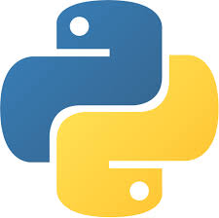

AI Master Class series – Day 21
Road Sign Recognition

Slide 2
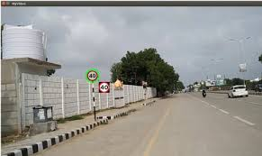
Road Sign Recognition.
Traffic-sign recognition (TSR) is a technology by which a vehicle is able to recognize the traffic signs put on the road e.g. "speed limit" or "children" or "turn ahead".
This is part of the features collectively called ADAS. The technology is being developed by a variety of automotive suppliers.
Dataset - GTSRB - German Traffic Sign Recognition Benchmark

Slide 3
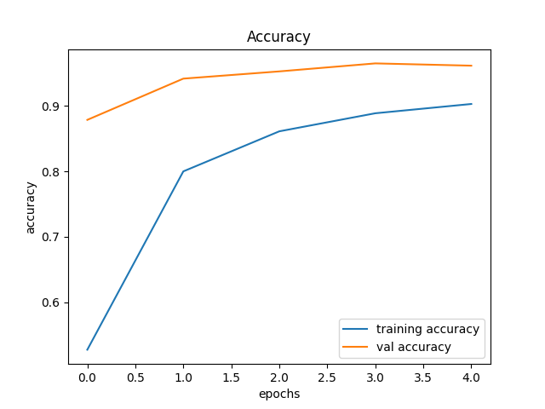
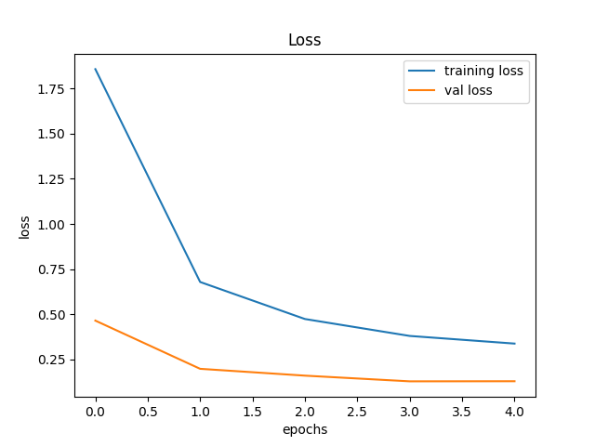
Display Accuracy & Loss Chart.
history = model.fit(X_train, y_train, batch_size=32, epochs=5, validation_data=(X_test, y_test))
plt.figure(0)
plt.plot(history.history['accuracy'], label='training accuracy')
plt.plot(history.history['val_accuracy'], label='val accuracy')
plt.title('Accuracy')
plt.xlabel('epochs')
plt.ylabel('accuracy')
plt.legend()
plt.savefig('Accuracy.png')
plt.figure(1)
plt.plot(history.history['loss'], label='training loss')
plt.plot(history.history['val_loss'], label='val loss')
plt.title('Loss')
plt.xlabel('epochs')
plt.ylabel('loss')
plt.legend()
plt.savefig('Loss.png')
self.textEdit.setText("Saved Model & Graph to disk")

Slide 4

! PRACTICAL SESSION !
Road Sign Recognition

Slide 5
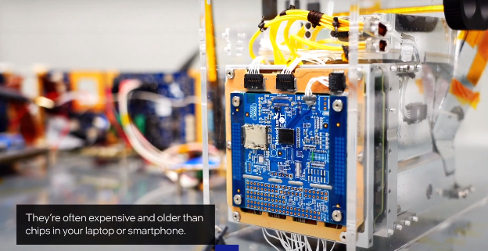
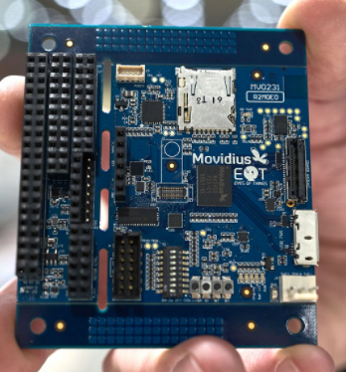
AI News – Day 21. OCT - 2020
Intel has integrated its Movidius Myriad 2 Vision Processing Unit (VPU) into PhiSat-1 – enabling large amounts of data to be processed on the device. This helps to prevent useless data being sent back to Earth and consuming precious bandwidth.
The PhiSat-1 satellite is about the size of a cereal box and was ejected from a rocket’s dispenser alongside 45 other satellites. The rocket launched from Guiana Space Centre on September 2nd.

Slide 6
Thanks!
Tomorrow session
Introduction to Machine Learning

Slide 7
Day-21 Agenda.
01.
02.
03.
Road Sign Recognition
DL Syntax
Deployment
05.
Q & A
Road sign recognition & Application
Accuracy & Loss Plot
Road sign recognition

